Slide 1
LPC 2148 Architecture and Features
CDAC Mumbai

Slide 2
Features of LPC 2148
16/32-bit ARM7TDMI-S microcontroller in a tiny LQFP64 package.
40 kB of on-chip static RAM and 512 kB of on-chip flash program memory.
128 bit wide interface/accelerator enables high speed 60 MHz operation.
In-System/In-Application Programming (ISP/IAP) via on-chip boot-loader software.
Embedded ICE RT and Embedded Trace interfaces offer real-time debugging with the on-chip Real Monitor software and high speed tracing of instruction execution.
USB 2.0 Full Speed compliant Device Controller with 2 kB of endpoint RAM.
In addition, the LPC2148 provide 8 kB of on-chip RAM accessible to USB by DMA.

Slide 3
Features Contd..
Two 10-bit A/D converters provide a total of 14 analog inputs, with conversion times as low as 2.44 μs per channel.
Single 10-bit D/A converter provides variable analog output.
Two 32-bit timers/external event counters (with four capture and four compare channels each), PWM unit (six outputs) and watchdog.
Low power real-time clock with independent power and dedicated 32 kHz clock input.
Multiple serial interfaces including two UARTs (16C550), two Fast I2C-bus (400 kbit/s), SPI and SSP with buffering and variable data length capabilities.
Vectored interrupt controller with configurable priorities and vector addresses.
Up to 45 of 5 V tolerant fast general purpose I/O pins in a tiny LQFP64 package.
Up to nine edge or level sensitive external interrupt pins available.

Slide 4
More Features
60 MHz maximum CPU clock available from programmable on-chip PLL with settling time of 100 μs.
On-chip integrated oscillator operates with an external crystal in range from 1 MHz to 30 MHz and with an external oscillator up to 50 MHz.
Power saving modes include Idle and Power-down.
Individual enable/disable of peripheral functions as well as peripheral clock scaling for additional power optimization.
Processor wake-up from Power-down mode via external interrupt, USB, Brown-Out Detect (BOD) or Real-Time Clock (RTC).
Single power supply chip with Power-On Reset (POR) and BOD circuits:
CPU operating voltage range of 3.0 V to 3.6 V (3.3 V ± 10 %) with 5 V tolerant I/O pads.

Slide 5
LPC 2148 Architecture

Slide 6
Advance Microcontroller Bus Architecture(AMBA)
3 Types of Buses
Advanced High performance bus(AHB)
VLSI/Advanced Peripheral Bus(VPB/APB)
Local Bus

Slide 7
Advance Microcontroller Bus Architecture(AMBA)
AHB is the fastest way of connecting peripheral devices to the ARM7 core
Since the Interrupt vector controller is responsible for managing all the device interrupt sources, it is connected to the ARM7 core by AHB
All the remaining user peripherals are connected to the VPB
The VPB bridge contains a clock divider, so the VPB bus can run at a slower speed than ARM7 core AHB bus.
Hence when the user peripherals run at a slower clock rate than the main processor power is conserved.
And it also provides the privilege in future enhancements to add a slower peripheral the processor core family.

Slide 8
Advance Microcontroller Bus Architecture(AMBA)
Currently, all the on-chip peripherals are capable of running at 60MHz so the VPB bus can be set to the same speed as the AHB
On Reset,VPB divider is set to divide down the AHB clock by four
Hence, all the on-chip peripherals will be running at 1/4th the CPU clock frequency.

Slide 9
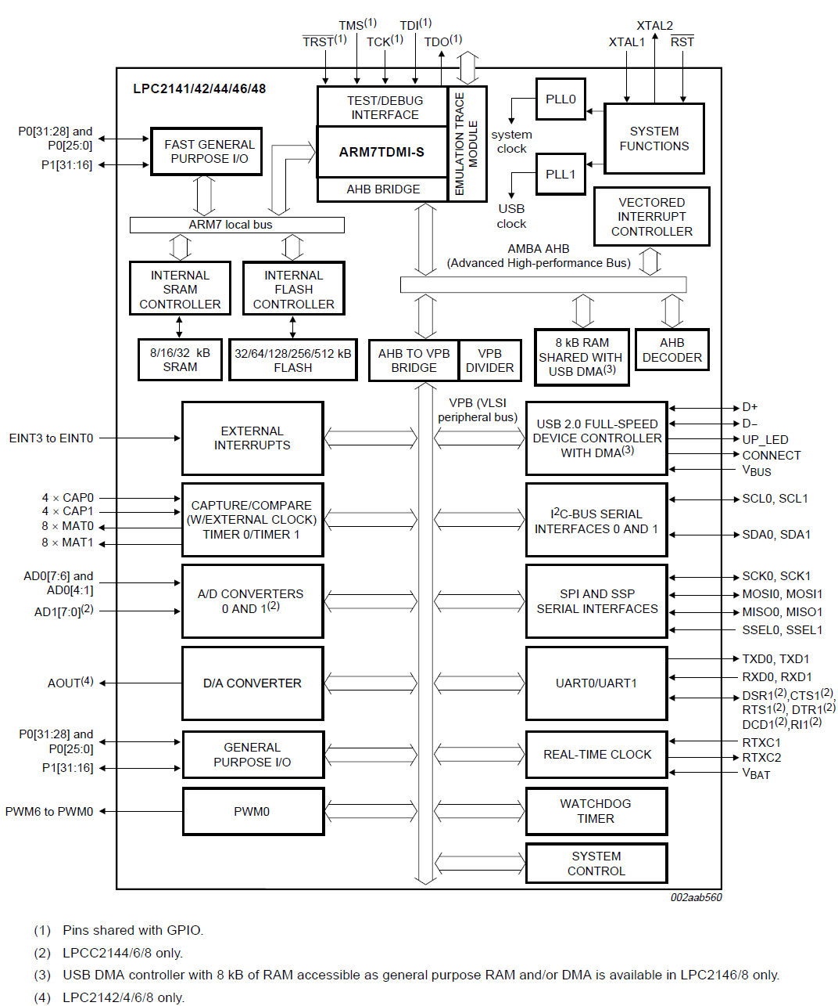

Slide 10
Memory Map

Slide 11
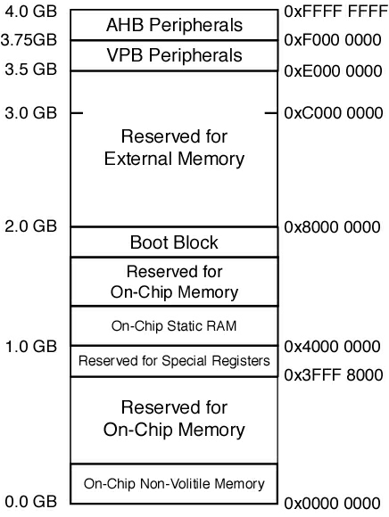

Slide 13
Accessing Peripherals
Both the AHB and VPB peripheral areas are 2 megabyte spaces which are divided up into 128 peripherals.
Each peripheral is allocated a 16K memory page.
The Vector Interrupt unit is located at the top address range at 0xFFFFF000
All peripherals are memory-mapped, they can be accessed as normal memory locations.
Each SFR location can be accessed by hardwiring a volatile pointer to its memory location as shown below.
#define SFR (*((volatile unsigned long *) 0xFFFFF000))

Slide 14
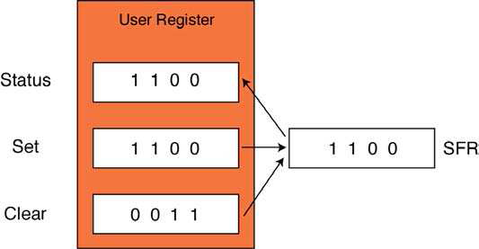
Register programming

Slide 15
PIN Connect block
The purpose of the Pin Connect Block is to configure the microcontroller pins to the desired functions.
All of the I/O pins on the LPC2148 (ARM7 TDMI) are connected to a number of internal functions via a multiplexer called the pin connect block.
The pin select block allows a user to configure a pin as GPIO or select up to three other functions.

Slide 16
PIN Connect block
Mux
PINSEL0 : Configures PORT0.0 to PORT0.15
PINSEL1 : Configures PORT0.16 to PORT 0.31
PINSEL2 : Configures PORT 1.15 to PORT 1.31

Slide 17
General Purpose I/O
On reset the pin connect block configures all the peripheral pins to be general purpose I/O(GPIO) input pins.
The GPIO pins are controlled by four registers, as shown below.

Slide 18
General Purpose I/O
IOPIN : The current state of the GPIO configured port pins can always be read from this register, regardless of pin direction.
IOSET : This register controls the state of output pins in conjunction with the IOCLR register. Writing ones produces highs at the corresponding port pins. Writing zeroes has no effect.
IODIR : This register individually controls the direction of each port pin.
IOCLR : This register controls the state of output pins. Writing ones produces lows at the corresponding port pins and clears the corresponding bits in the IOSET register. Writing zeroes has no effect.

Slide 19
Phase Locked Loop
Takes an external oscillator frequency from between 10MHz – 25MHz from a fundamental crystal and multiply this frequency up to a maximum of 60MHz to provide the on-chip clocks for the ARM7 CPU and peripherals.

Slide 20
Why use PLL
This allows the LPC2148 to run at its maximum frequency with a low value external oscillator, thus minimizing the EMC emissions (i.e. noise) of the LPC2148.
The PLL output frequency can also be changed dynamically, allowing the device to throttle back its execution speed in order to conserve power when it is idling.

Slide 21
Within the PLL are two constants which must be programmed in order to determine the clock for the CPU and AHB.
The first constant is a straightforward multiplier of the external crystal. The output frequency of the PLL is given by
Cclk = M x Osc
In the feedback path of the PLL is a current-controlled oscillator which must operate in the range 156MHz – 320 MHz.. The second constant acts as a programmable divider which ensures that the CCO is kept in specification. The operating frequency of the CCO is defined as
Fcco = Cclk x 2 x P

Slide 22
The programming interface for the PLL is shown below.

Slide 23
For transferring values written to the user SFRs to the internal PLL registers a feed sequence is written to the PLL feed register. Hence, Update the PLLCON and PLLCFG registers,
you must write 0x000000AA followed by 0x00000055 (the PLLFEED register) on consecutive cycles.
To set up the PLL you must write the values for P and M to the PLLCFG register.
The PLL is enabled using PLLCON register.
This starts up the PLL which is monitored by reading the LOCK bit in the PLLSTATUS register.
Once the PLL has locked as a stable clock source, it can replace the external oscillator as the source for Cclk.
This is done via the PLLC bit in the PLLCON register

Slide 24
void init_PLL(void)
{
PLLCFG = 0x00000024; // Set multiplier and divider of PLL to
// give 60.00 MHz
PLLCON = 0x00000001; // Enable the PLL
PLLFEED = 0x000000AA; // Update PLL registers with feed sequence
PLLFEED = 0x00000055;
while (!(PLLSTAT & 0x00000400)); // test Lock bit
PLLCON = 0x00000003; // Connect the PLL
PLLFEED = 0x000000AA; //Update PLL registers
PLLFEED = 0x00000055;
VPBDIV = 0x00000002; //Set the VLSI peripheral bus to 30.000MHz
}

